Slide 1
Scientific Method

Slide 2
I. Question
Define a problem
GOOD SCIENCE QUESTIONS ARE:
Testable
Measureable
Observable
Repeatable

Slide 3
II. Background Information/Research
Write out any information you need to share with the reader so that they can understand what your experiment is about!
Research to see if others have done your experiment, what were their results? Gives you a better idea what to expect.

Slide 4
III. Hypothesis
What is going to be tested by the experiment
Based on your research what you predict will happen
Should include what you’re going to change and what will happen if you do (If… then….)

Slide 5
Hypothesis Practice
If the question is…
What causes people’s toenails to grow faster?
A good hypothesis would be…
An increase of vitamin A causes toenails to grow longer

Slide 6
Hypothesis Practice
If the question is…
Does music affect a person’s heart rate?
A good hypothesis would be…
When exposed to music with a rapid tempo, their heart rate will increase
Your turn… If the question is…
Do pill bugs prefer moist or dry environments?
A good hypothesis would be….

Slide 7
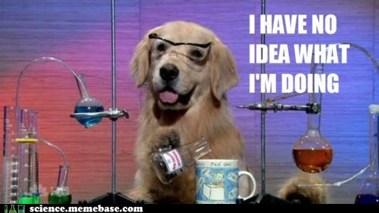
IV. Experimental Procedure
This is the step by step description of exactly how to carry out the experiment
….
….
….
And so on
Should be detailed enough to be
Repeatable
Done safely
Easy to adjust if something goes wrong
Multiple Trials (repeat the experiment)
The more data you have the more reliable your conclusion will be
Want to have the largest sample size/data collection possible

Slide 8
V. Data
Organized chart and/or graph of the information you gathered
Display appropriate units

Slide 9
VI. Conclusion
Restate your hypothesis
Accept, reject (nullify), or inconclusive BASED ON DATA
Include a discussion of data
Discusses the validity of the experiment

Slide 10
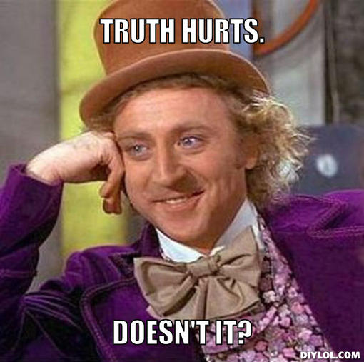
What does it mean to nullify a hypothesis?
Your results don’t support your hypothesis
DO NOT
Change your hypothesis to match your data
Change your data to match your hypothesis
Toss out your experiment as a failure

Slide 11
Variables
Independent (Experimental) Variable: part of the experiment that the scientist changes, ONLY ONE PER EXPERIMENT
The experimental group is the part of the experiment where you are testing something new out
Why only one independent variable?

Slide 12
Dependent Variable: the part of the experiment that changes because of the independent variable, part that is measured
Control Group: done without the independent variable, something to compare to

Slide 13
Laws and Theories
Scientific Law: a descriptive statement or equation that reliably predicts events under certain conditions, helps us make predictions
Universal law of gravity

Slide 14
Scientific Theories: explains why things work, supported by a large amount of evidence (observations) and investigations (experiments)
** Always being questioned and examined
Theory of evolution

