Slide 1
Newton’s 3rd Law of Motion

Slide 2
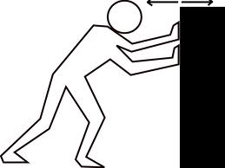
Newton’s 3rd Law – For every action, there is an equal but opposite reaction.
Example: When you push on a wall, the wall pushes back on you with a force equal in strength to the force you exerted but opposite in direction.

Slide 3
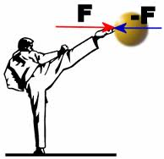
- According to Newton’s third law of motion: forces always act in equal but opposite pairs
- The forces exerted by two objects on each other are often called an action-reaction force pair
- Action and reaction force pairs don’t cancel because they act on DIFFERENT objects

Slide 4
Newton’s 3rd Law
http://youtu.be/cP0Bb3WXJ_k

Slide 5
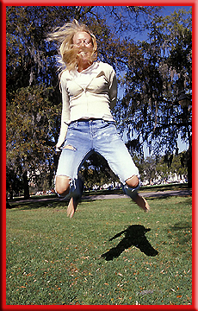
Examples:
Jumping – when you jump, you push down on the ground.
The ground then pushes up on you. It is this upward force that pushes you into the air.

Slide 6
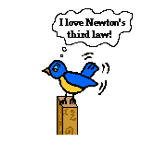
Examples:
Birds Flying – when a bird flies, its wings push in a downward and backward direction.
- This pushes air back downward and backward.
- By Newton’s third law, the air pushes back on the bird in the opposite directions – upward and forward
- This force keeps the bird in the air and propels it forward

Slide 7
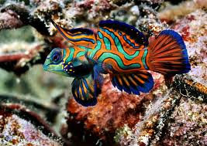
Your Turn… Identify the action and reaction in the following scenarios
A fish’s fins pushing water backwards
Action –
Reaction –

Slide 8
A butterfly’s wings push air downwards
Action –
Reaction –
A car hits a cement wall
Action –
Reaction –
Tires on a car push the road backwards
Action –
Reaction –

Slide 9
Law’s of Motion – Black and Yellow Remix
http://youtu.be/vZXJnqUEXRA

Slide 10
Newton’s Third Law on Large and Small Objects
Walking on Earth
- When you walk forward, you push backward on the ground
- Your shoe pushes Earth backward, and Earth pushes your shoe forward
- Earth has so much mass compared to you that it does not move noticeably when you push it

Slide 11
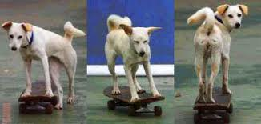
- If you step on something that has less mass than you do, like a skateboard, you can see it being pushed back

Slide 12
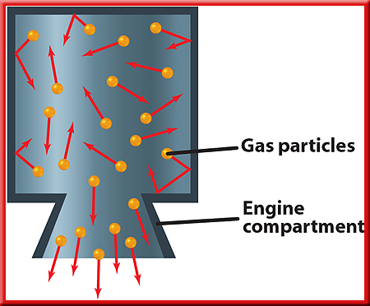
A Rocket Launch
- When the rocket fuel is ignited, a hot gas is produced
- As the gas molecules collide with the inside engine walls, the walls exert a force that pushes them out of the bottom of the engine
- This downward push is the action force

Slide 13
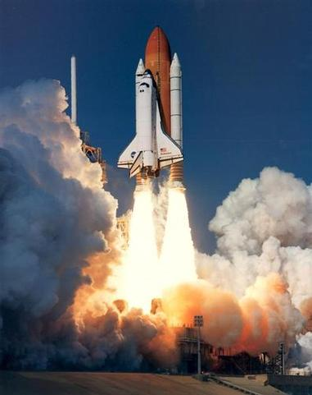
The reaction force is the upward push on the rocket engine by the gas molecules
This is the thrust that propels the rocket upward

