Slide 2
Photon

Slide 3
NADPH

Slide 4
ATP

Slide 5
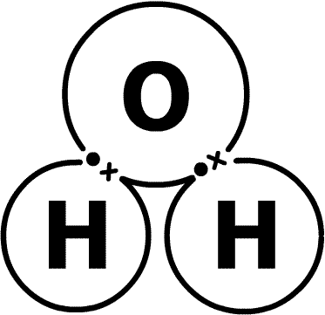

Slide 6
e-

