Slide 1
Genetic Engineering

Slide 2
What is Genetic Engineering?
- the deliberate (not accidental) alteration of the genetic material of an organism.
- an advanced technology – way beyond selecting which plant to cross with another(watch out Mendel)
- often involves the insertion of copies of a gene from one organism into another.

Slide 3
How can this be done?
DNA is manipulated – genes substituted from one organism into another to achieve a desired offspring or product.

Slide 4
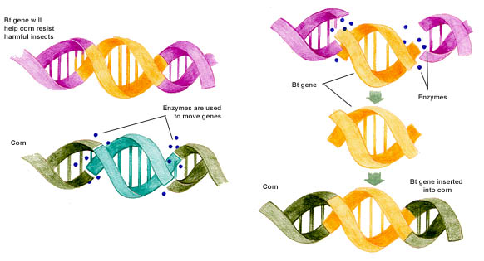
Genes added to Corn

Slide 5
Genetic Engineering in Plants
increases speed of growth
Allows for faster production, increased food supply
increased disease resistance
- allows for the reduction of use of pesticides or herbicides
increased nutritional content

Slide 6
More examples…

Slide 7
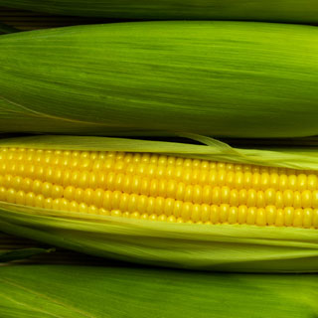
Looks really good…

Slide 8
Trees engineered to grow quickly
United Streaming Video
The Advantages of Genetically Modified Food Supplies
How Stuff Works – Timber
http://www.youtube.com/watch?v=bIJQRNYyHY4

Slide 9
Not just plants, animals too..
Engineered to
Grow faster
Increase muscle / less fat
Produce milk / eggs with greater nutritional value

Slide 10
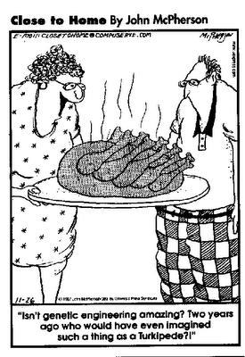
So it’s all good, right?

Slide 11
GMO’s OH MY!
Genetically Modified Organisms… Especially FOOD! Two sides to the debate
Scientists Address the Opposition to Genetically Modified Crops
http://player.discoveryeducation.com/index.cfm?guidAssetId=85B20568-A020-4A51-8558-0E4E2269B8B1&blnFromSearch=1&productcode=US

Slide 12
And Medicines..
Insulin, needed by diabetics, is produced by genetically engineered bacteria.
http://www.youtube.com/watch?v=m3925Pw-VwU

Slide 13
Why use Genetic Engineering?
Prior to 1978, diabetics had to use insulin from bovine or swine (cattle/pig) sources.
This insulin caused allergic reactions in ~5% of people.
The genetically engineered insulin is much better tolerated by humans.

Slide 14
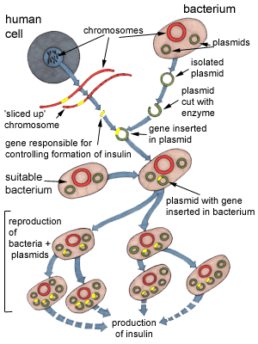
Bacteria make insulin

Slide 15
Genetic Engineering and Hemophilia
Hemophiliacs have a bleeding disorder due to the lack of a specific protein, called Factor VIII.
Transfused Factor VIII from human donors has resulted in the transmission of disease to hemophiliacs from donors (HIV in the 1980s)
Genetic engineering has been able to produce Factor VIII that carries none of these risks.

Slide 16
Genetic Engineering Concerns
- Are genetically engineered foods safe?
- Will there be unintended consequences?
- to plants
- to humans
- to wildlife

Slide 17
Genetically Modified Foods
Read the article from The Science Creative Quarterly
Answer the questions from the reading.

