Slide 1
DNA Replication

Slide 2
http://www.youtube.com/watch?v=z685FFqmrpo

Slide 3
Replication
Replication: The process of duplicating (copying) DNA
This must take place before cell division.
Why is there DNA replication?
One copy will power the original cell, the other will be for the new cell.

Slide 4
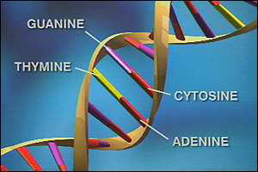
Remember: DNA is made out of two strands. They are complementary to each other (bases on one strand determines the sequence on the other)

Slide 5
Base Pairs: Adenine (A) – Thymine (T) Guanine (G) – Cytosine (C)
Practice Strands
If one side of the DNA strand reads….
GACTCGATCCCG
What will the other be?

Slide 6
Examples: (Write down both the original strand given and the complementary strand you transcribe)
#1 – CCGATAGCA
#2 - ATCGAATCA

Slide 7
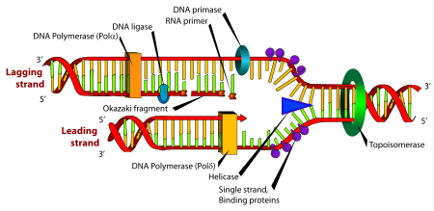
Steps in Replication
1. DNA Helicase unwinds the DNA (like a zipper unzipping) and creates a replication fork, it does this by dissolving the hydrogen bonds

Slide 8
Steps in Replication
2. DNA polymerase adds the complementary bases. The DNA polymerase travels from the 3’ end to the 5’ end. This is the leading strand.

Slide 9
Steps in Replication
3. DNA polymerase adds the complementary bases to the other side of the ladder, travels in the opposite direction. It completes the strand in several fragments called Okazaki Fragments. These fragments are bound together by DNA ligase.

Slide 11
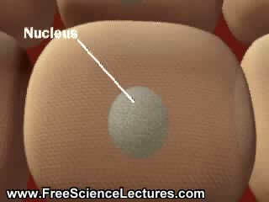
DNA Replication Clip http://www.youtube.com/watch?v=WBKPtTW_94o

Slide 12
Top 5 Biology Music Video
http://youtu.be/dIZpb93NYlw

