Slide 1
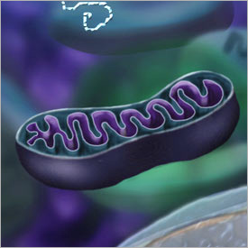
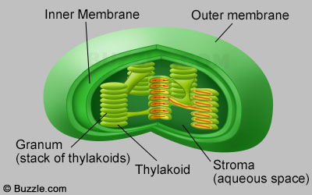
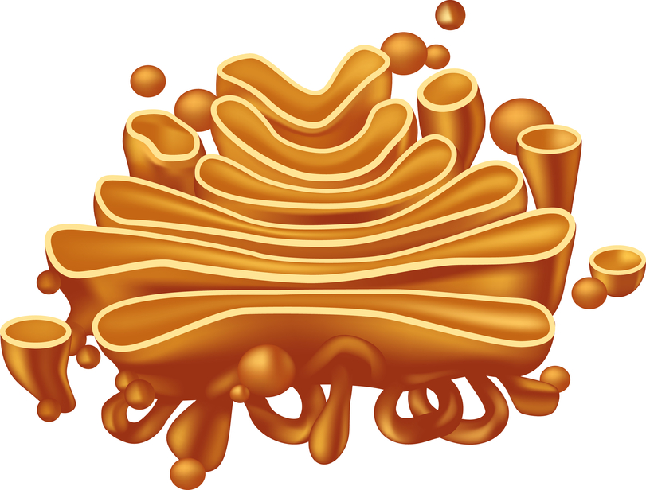
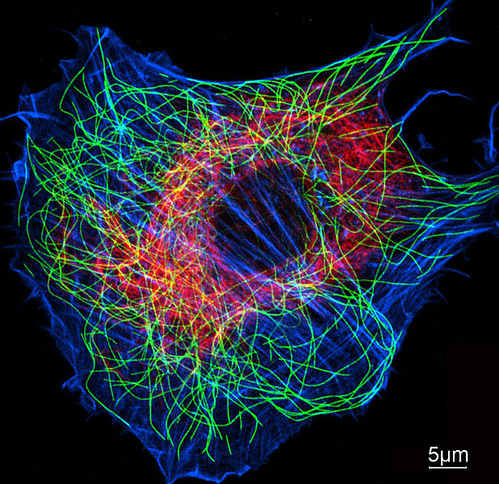
Name: Ms. Pilarz
Facebook Character: Mitochondria
Hour: 2nd
facebook Home Profile Friends Inbox
Macho Mitochondria Lighting the fire of energy at every turn
Insert a Profile Pic here
What’s on your mind… I’ve got energy to burn, who’s with me?!
Share
Wall
View Photos of me (8)
Send me a message
Insert picture
Sup Macho Mitochondria, I’ve been busy chefing it up in the kitchen… come over for some tasty grub. ~ Cutey Chloroplast
6 minutes ago
I can make over a 100 molecules of ATP in a second. Whoa… that’s a lot of power!!
Insert picture
I’m gearing up for the holiday season, anything you want me to package and ship??
~ Gorgeous Golgi Body
2 hours ago
General Information
Insert picture
Yo man how your structure doing, I can always lend a hand to give you some extra support?
~ Creative Cytoskeleton
Co-workers:
Nucleus, Cell Membrane
Enter date
Birthday:
1967
Job Description:
Insert picture
Enter message/ note/ or link here here
Provide the energy for a cell, ATP baby (yea you know me!)
Enter date
Information
Friends
Personal Information
Insert picture here
Insert picture here
Activities:
Insert organelle activities here (should be related to their functions)
Favorite Organelle:
Insert favorite organelle here & describe why it’s your favorite
NAME
NAME
Favorite Cells:
Are these found in prokaryotic or eukaryotic cells (or both!), if eukaryotic also say whether they are found in plant or animal cells
Insert picture here
Insert picture here
Organelle History
Discovery:
Insert organelle history here. Who discovered your organelle? How it was discovered, when it was discovered. Ect.
NAME
NAME

